Slide 1
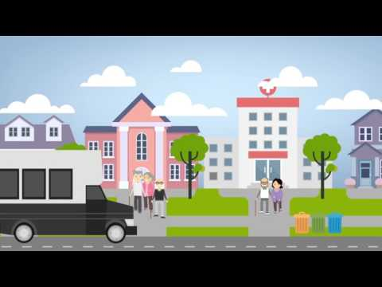
Transportation Disadvantaged Taskforce
August 2, 2017
Danielle McGill

Slide 2

Overview
Danielle McGill
Transportation Advocate for Individuals with Disabilities
Ann Storck Center & Policy Leadership Fellow
Perspective: Transit Rider & Transportation Professional

Slide 3
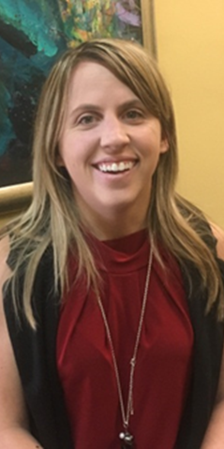
Danielle McGill
Born with Cerebral Palsy
Independent
Passionate Advocate
Former Taekwondo Instructor Assistant for children with developmental disabilities
Disability Youth Leadership Ambassador for The Able Trust
Disability Representative in Student Government at F.I.U.
Club ABLED founder at F.I.U.
Florida International University Graduate
Former Legislative Assistant Intern for State Senator Rene Garcia
Policy Leadership Fellow at Ann Storck Center

Slide 4
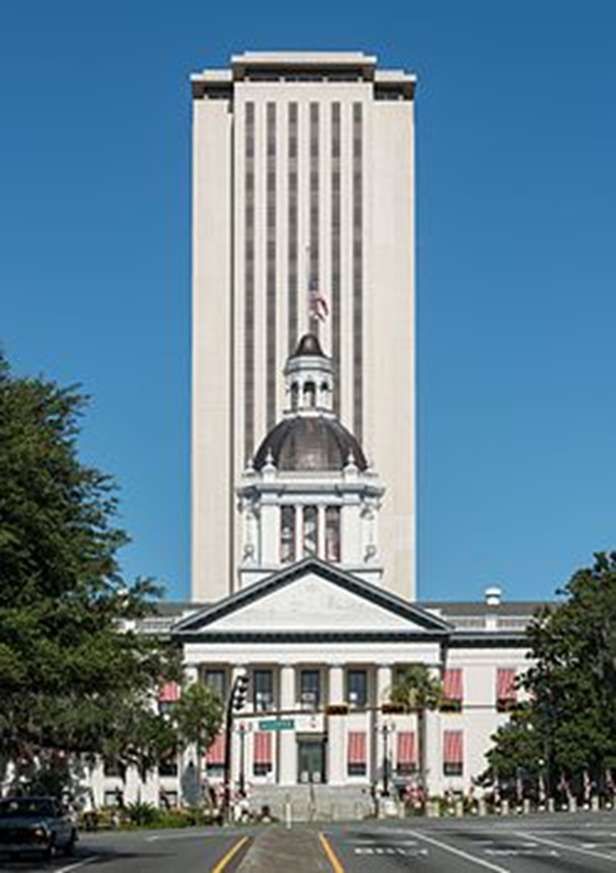
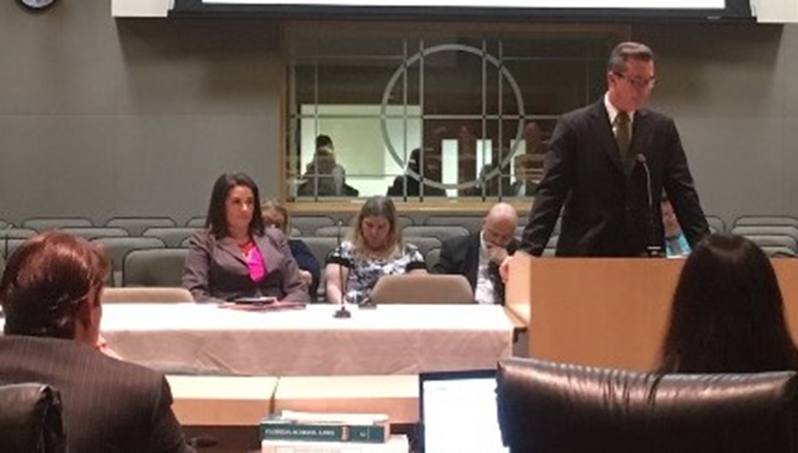
Transportation Advocate
State Senator Garcia introduces SB 1086 to Transportation Committee
The goal of the SB 1086 was to amend the Transportation for the Disadvantaged services authorizing the use of uniformed fare payment system to be used by individuals with disabilities while traveling cross-county boundaries to their destination.

Slide 5
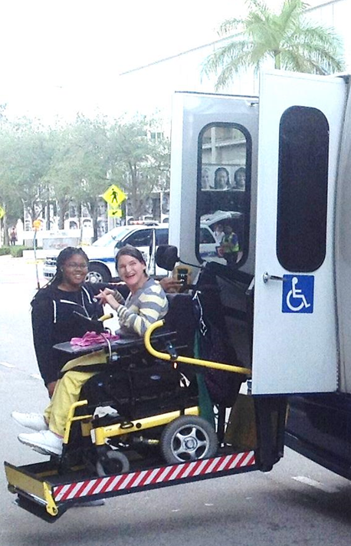
Dedicated to enriching the lives of children and adults with developmental disabilities
1950s Ann Storck opened the Pediatric Care Center
In 1981 the Pediatric Care Center became Ann Storck Center, Inc.
PROGRAMS: Residential Services, Transportation Services, Adult Day Training, Early Intervention Preschool, Expressive Arts and Hi-Ability Therapy Program
Serving 300 individuals daily on 25,000 sq. feet of living and learning space

Slide 6
Mobility Management Facilitation Program (MMFP) & Policy Leadership Fellow
Missions
The Mobility Management Facilitation Program – “Community Transportation Connections: Enhancing Mobility for Every Ability” at Ann Storck Center is focused on improving coordinated transportation systems for individuals who are transportation disadvantaged within Broward and Palm Beach Counties.
Policy Leadership Fellowship through SARTAC’s mission is similar to the MMFP, but will focus on advocacy for individuals with disabilities and transportation

Slide 7


Policy Leadership Fellow
Self Advocacy Resource and Technical Assistance Center (SARTAC)
National self-advocacy center created to share self-advocacy information and opportunities across the country
Year-long opportunity for self-advocates to develop and grow their skills
Fellow work on supporting host organization on policy issues or a project that help develop leadership skills.

Slide 8
A Ride A Way Project
Educate seniors and individuals with disabilities on tips about self-advocacy and safety while accessing transportation to health, education, employment and life sustaining services.
Provide free resource information, instructional tools, and peer to peer support.
Cover a wide range of topics related to seniors and individuals with disabilities as part of their road to independence.
Share instructional material, personal experience on travel training by using a fixed-route service and various modes of transportation.
Create a Rider’s Advocacy Guide with learning tools to teach others how to advocate for themselves.

Slide 9
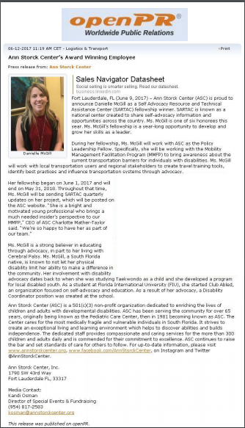
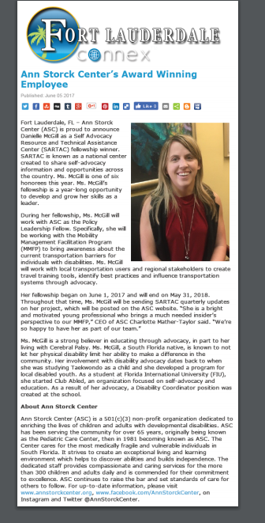
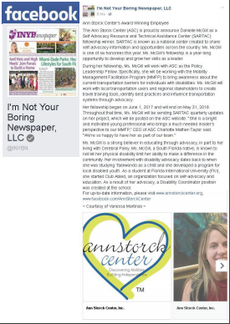
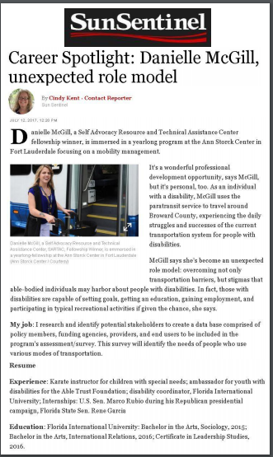
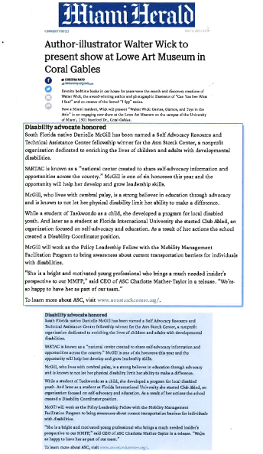
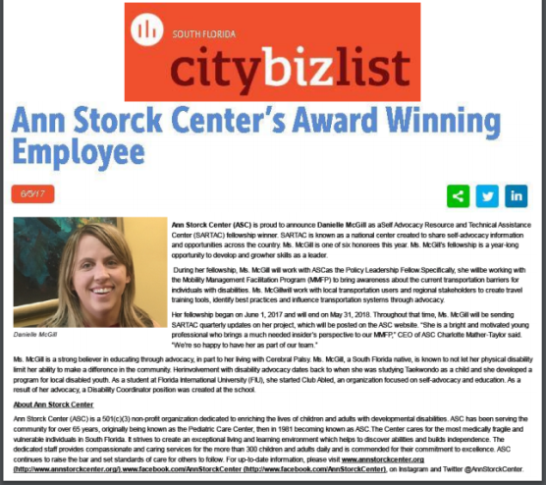
Getting the Word Out!

Slide 10
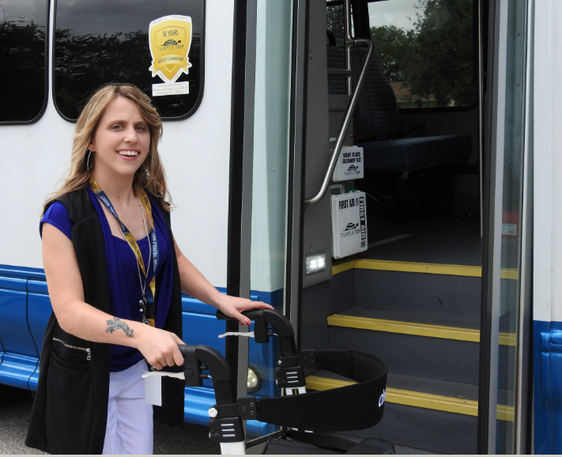
Benefits to Task Force
PERSONAL EXPERIENCE
Using Paratransit since 2004
4 Counties across Florida
TRANSIT EXPERIENCES
Lack of travel training/education
Long wait times
No inter-county transfers
Lack of proper notification for pick up
Left at wrong locations
Not picked up
Others impersonating me
Unsafe transfer points/transit stops
Impolite drivers
Inoperable equipment
Being on route for 2.5+ hours

Slide 11
Benefits to Task Force
PROFESSIONAL & PERSONAL EXPERIENCE
Using Paratransit since 2004
4 Counties across Florida
TRANSIT EXPERIENCES
Lack of travel training/education
Long wait times
No inter-county transfers
Lack of proper notification for pick up
Left at wrong locations
Not picked up
Others impersonating me
Unsafe transfer points/transit stops
Impolite drivers
Inoperable equipment
Being on route for 2.5+ hours

Slide 12




Moving Forward
Situational Appraisal
End User Survey
Presentations to Advocacy Organizations
Writing articles called Transit Diary “Rider Insider”, newsletters and blogs, Facebook
Presentation at the Transportation Disadvantaged Legislative Day in Tallahassee, March 2018.
Presentation at the SARTAC National Self Advocacy Conference May 2018.
My Goal: To share my personal insight, from a rider’s perspective about my daily challenges and encourage other riders in the community to share.

Slide 13
Questions?

Slide 14

The Journey to Independence is only … “A Ride Away”
Telephone: 888-825-TRIP (8747)
Transit Email Address: Mobilitymanagement@annstorckcenter.org
Please visit us at http://www.annstorckcenter.org/mobility-management-program

